Slide 1


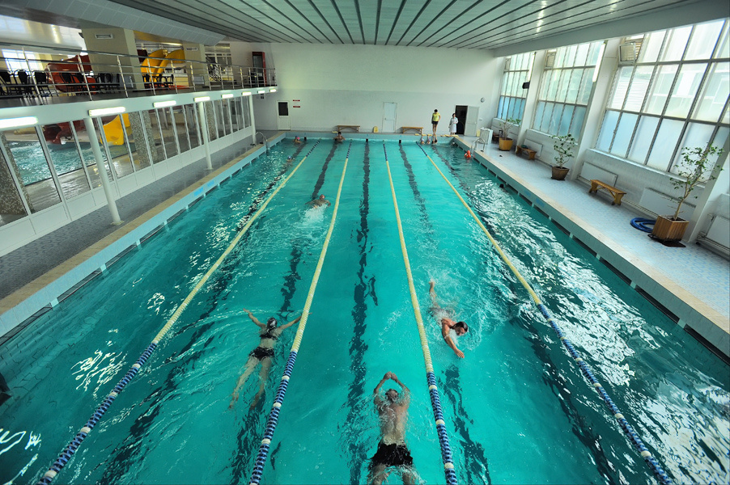
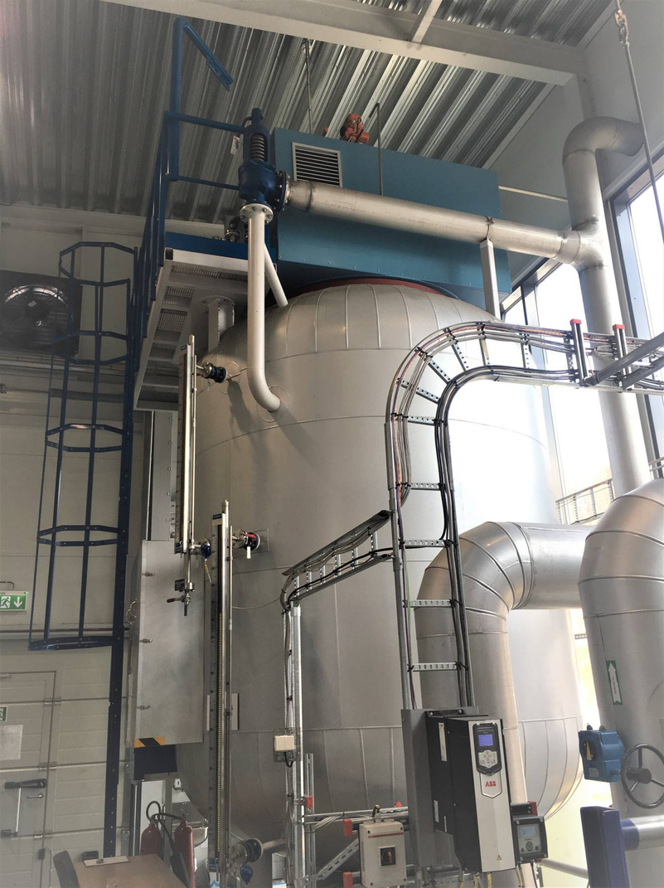


Boiler house reconstruction project with the installation of a high-voltage electric boiler with a storage tank

Slide 2

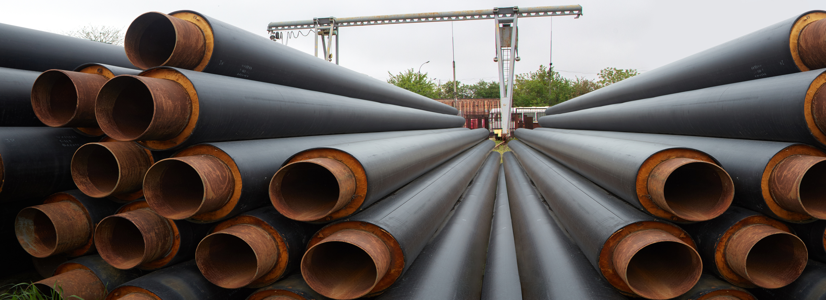







Boiler house reconstruction project with the installation of a high-voltage electric boiler with a storage tank
Reconstruction project of the boiler house at 10 Yevhenia Kukhartsia Street
The project includes the following works:
purchase of equipment
installation of equipment
commissioning
thermal capacity: 9 MW
The total cost of the project is
≈ €1.1 million

